Slide 1
Software Testing
SFT221
Instructor: Kaveh Eshraghian

Slide 2
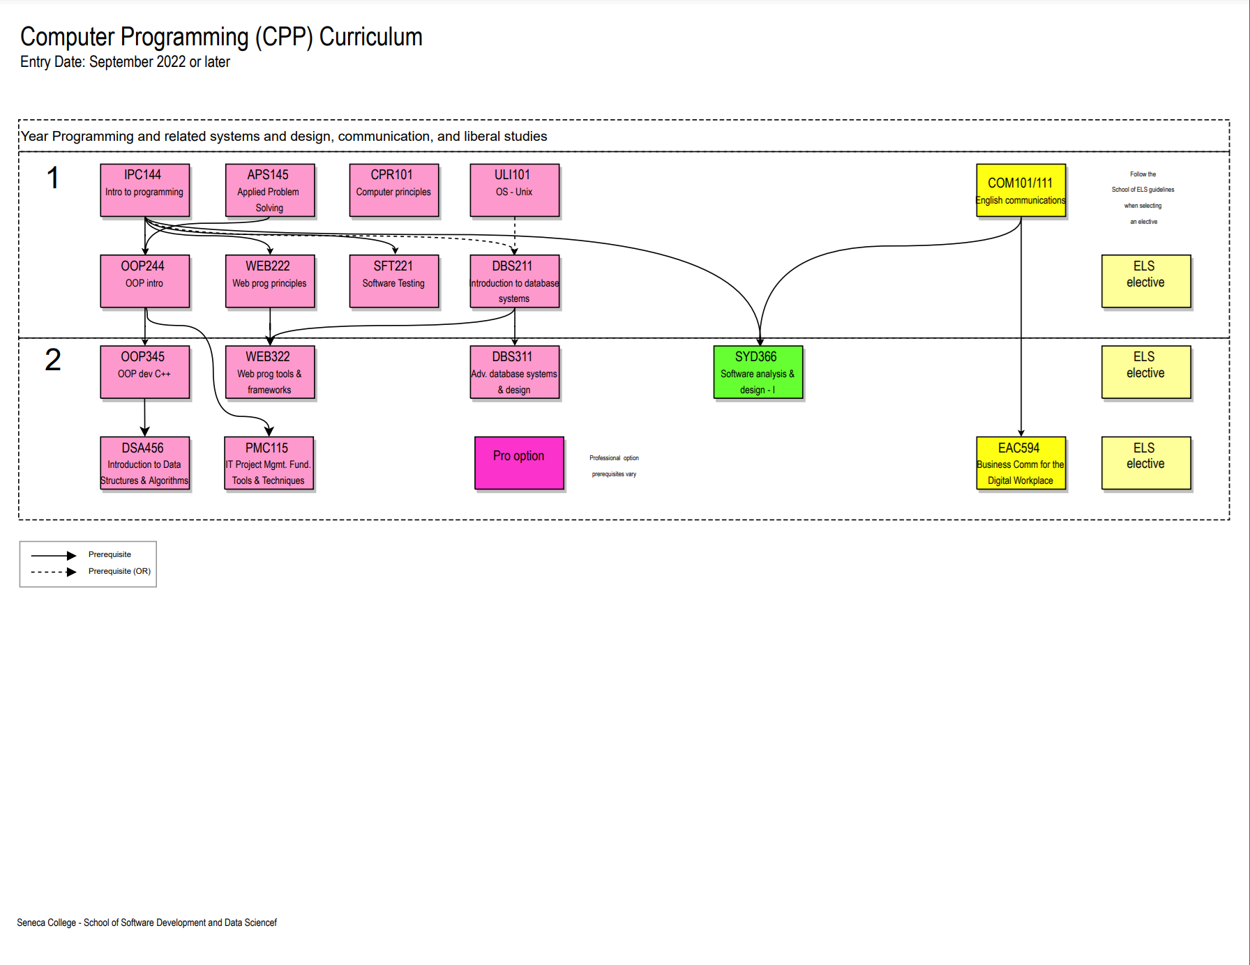

Slide 3
Rationale
Students will learn:
The types of errors
How to debug
How to test code
The quality assurance process

Slide 4
Learning Outcomes
Select data to test software completely and efficiently.
Build and execute unit tests to validate that software meets requirements.
Use multiple tools to find bugs in software.
Employ software testing as part of the software life cycle to validate that software meets requirements.
Employ tools to manage the software testing life cycle.

Slide 5
Outline
Types of errors
Common reasons for errors
Visual Studio Debugger
Types of testing
Designing test data
Unit testing in Visual Studio
Test coverage
Software life cycle
Software testing life cycle
GIT for storing assets
JIRA for bug reporting and project management

Slide 6
Evaluation
6 workshops 20%
1 project 40%
6 milestones
2 presentations
3 Quizzes 40%
Course Policies
Passing Criteria:
Passing average for the course; and
Weighted passing average for all Tests.
Each student has an allowance of 2 late days for individual work.
Teams have an allowance of 4 late days for teamwork.

